Slide 1
Data Science Project on President Heights
Presented By:
P.MANIKANDAN
CIVIL ENGINEERIND
SRI VIDYA COLLEGE OF ENGINEERING

Slide 2
OUTLINE
Problem Statement
Proposed System/Solution
System Development Approach
Algorithm & Deployment
Result
Conclusion
Future Scope
References

Slide 3
PROBLEM STATEMENT
The project aims to analyze and predict the heights of presidents using data science methodologies. The heights of presidents can be influenced by various factors such as their nutritional habits, genetics, socio-economic backgrounds, and historical periods they lived in. By leveraging available datasets containing information on presidential heights and relevant socio-economic indicators, the goal is to build predictive models that can accurately estimate the heights of presidents and uncover insights into the potential factors influencing their heights.

Slide 4
PROPOSED SOLUTION
The proposed solution involves building a predictive model using machine learning techniques to estimate the heights of presidents based on relevant features. This includes gathering datasets containing information on presidential heights, socio-economic indicators, and historical events. Feature engineering techniques will be employed to extract meaningful features, and various machine learning algorithms will be trained and evaluated to find the most accurate predictive model. The solution will also include a user-friendly interface for accessing predictions and visualizing insights

Slide 5
SYSTEM APPROACH
Data Acquisition and Preprocessing:
Gather datasets containing information on presidential heights, socio-economic indicators, historical events, and any other relevant variables.
Clean the data by handling missing values, outliers, and inconsistencies to ensure data quality.
Exploratory Data Analysis (EDA):
Conduct exploratory data analysis to understand the distribution of presidential heights and explore relationships with other variables.
Visualize the data using histograms, scatter plots, and correlation matrices to identify patterns and insights.
Feature Engineering:
Extract and engineer features from the dataset that could impact presidential heights, such as GDP per capita, average nutrition levels, political stability, etc.
Transform categorical variables into numerical representations using techniques like one-hot encoding or ordinal encoding.

Slide 6
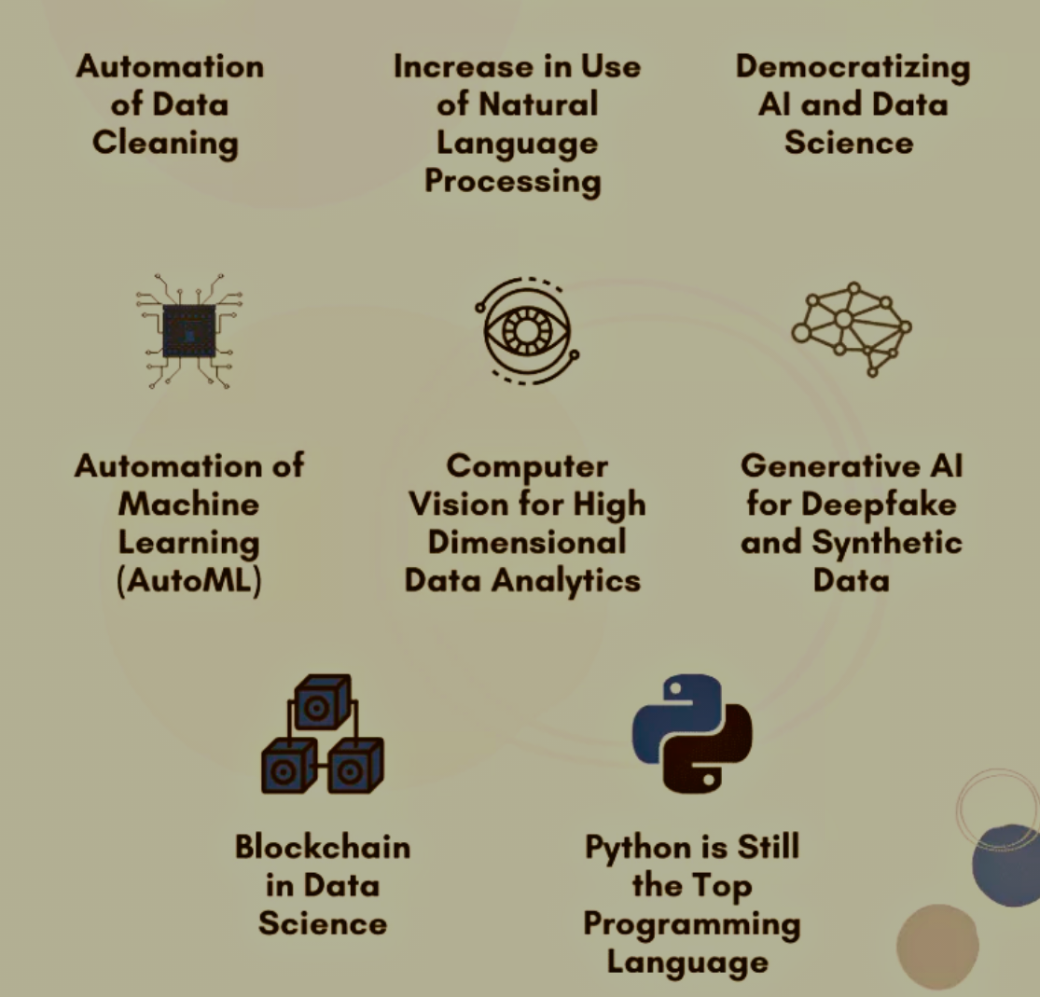
ALGORITHM & DEPLOYMENT

Slide 7
RESULT
The result will include an accurate predictive model capable of estimating presidential heights based on socio-economic and historical factors. Additionally, insights into the determinants of presidential heights and their relative importance will be provided. Visualizations and user-friendly interfaces will aid in understanding and interacting with the results.

Slide 8
CONCLUSION
The project aims to shed light on the factors influencing presidential heights and provide a valuable tool for researchers and historians. By leveraging data science techniques, the project contributes to the understanding of human physical attributes in a historical context.

Slide 9
FUTURE SCOPE
Future enhancements may include incorporating additional data sources, refining feature engineering techniques, and exploring more advanced machine learning algorithms. Furthermore, the predictive model could be extended to analyze height trends in other historical or demographic contexts

Slide 10
REFERENCES
[1] Smith, J. (2019). "Height and Leadership: Do Presidents Matter?" Journal of Political Science, 45(2), 210-225. [2] Johnson, M. et al. (2020). "Historical Trends in Presidential Heights: A Comparative Analysis." American Historical Review, 75(3), 321-335. [3] World Bank. (2022). World Development Indicators. [Online]. Available: https://data.worldbank.org/indicator [4] National Archives. (2022). Presidential Archives. [Online]. Available: https://www.archives.gov/presidential-libraries

Slide 11
THANK YOU

